Slide 1

Socially Responsible Investing
Carlos Gattorno
Kristina Valenzuela
Sebastian Ramirez

Slide 2
Contents
Objective
Summary
Ask the Data
What is ESG Rating
Key Indicators
Approach
Methodology
Programming
Data Type
Analysis
Problem Solving
Use
Data Cleaning
Data Analysis

Slide 3

Objective
The focus of the project is to integrate Environmental, Social and Corporate Governance (ESG) into equity investment analysis and use Key Performance Indicators (KPI’s) to evaluate their ratings. We will summarize the stock pricing data, annual reports, and corporate governance policies as they align with global environmental goals for environmental and social sustainability in our analysis.
This Photo by Unknown Author is licensed under CC BY

Slide 4
Summary
What is ESG?
ESG stands for Environmental, Social and Corporate Governance,
(ESG) is a criteria and set of standards for a company's operations that socially conscious investors use to screen potential investments.
Environmental criteria consider how a company performs as a steward of nature. Social criteria examine how it manages relationships with employees, suppliers, customers, and the communities where it operates. Governance deals with a company’s leadership, executive pay, audits, internal controls, and shareholder rights.
The practice of ESG investing began in the 1960s as socially responsible investing, with investors excluding stocks or entire industries from their portfolios based on business activities such as tobacco production or involvement in the South African apartheid regime.
Today, ethical considerations and alignment with values remain common motivations of many ESG investors, but the field is rapidly growing and evolving, as many investors look to incorporate ESG factors into the investment process alongside traditional financial analysis.
ESG scores are based on relative ESG performance.
Newer more recent studies suggest that companies with robust ESG practices displayed a lower cost of capital, lower volatility, and fewer instances of bribery, corruption and fraud over certain time periods. Conversely, studies have shown that companies that performed poorly on ESG have had a higher cost of capital, higher volatility due to controversies and other incidences such as spills, labor strikes and fraud, and accounting and other governance irregularities.
In fact, numerous academic and investor studies in recent years have found historically lower risk and even outperformance over the medium to long term for portfolios that integrated key ESG factors alongside rigorous financial analysis.

Slide 5
Ask the data
What issues do research companies consider in their ESG ratings methodology?
What is the method used to obtain ESG scores, and company financials?
What does a good ESG rating and look like compared to a poor rating?
How can we incorporate ESG or sustainability scores in a programmatic way, for fundamental analysis?
What type of data will be required to perform the analysis?
How can we find this data?
What problems are we solving using the tool created?
Who would benefit from using a tool like this?

Slide 6
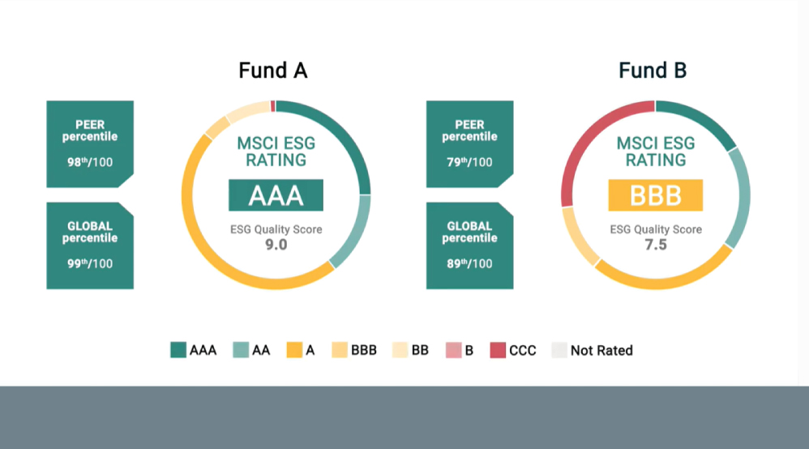
What is an ESG Rating?
An ESG Rating is designed to measure a company’s resilience to long-term, industry material environmental, social and governance (ESG) risks. We use a rules-based methodology to identify industry leaders and laggards according to their exposure to ESG risks and how well they manage those risks relative to peers. ESG Ratings range from leader (AAA, AA), average (A, BBB, BB) to laggard (B, CCC). We also rate equity and fixed income securities, loans, mutual funds, ETFs and countries.

Slide 7

Key Indicators
Key issues that ESG companies may consider when determining ratings include:
Environment - Carbon emission(product carbon footprint), Water Stress Biodiversity & Land Use, Toxic Emissions & Waste Packaging Material & Waste, Opportunities in Clean Tech Opportunities in Green Building.
Social - Labor Management Health & Safety, Product Safety & Quality Chemical Safety Financial Product Safety, Controversial Sourcing, Access to Communications Access to Finance,
Governance - Board Pay, Ownership / Accounting, Business Ethics Anti-Competitive Practices Tax Transparency Corruption & Instability (Financial System Instability).

Slide 8
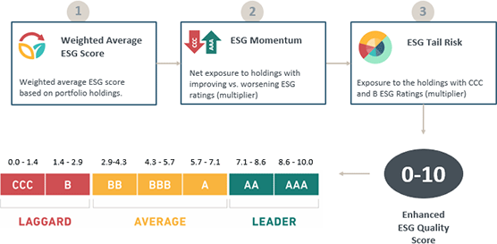
Approach
We looked for API codes and programs we could use to pull ESG scores for companies and compare them to the financial data. We found a couple of starter files for this data and began to manipulate it for our own analysis

Slide 9

Methodology
We collect the most relevant, publicly available data (web scraping) to get sustainability data (ESG scores) from yahoo finance and other API's like IEX Cloud to integrate into our analysis in order to compare a companies score with that of its peer group.
The metrics that we use are the ESG scores plus Revenue, Net income, Earning per share growth, and EBITDA growth, and discounted cash flow (DCF)
These are the KPI’s we use to measure a companies financial performance.
This Photo by Unknown Author is licensed under CC BY

Slide 10
Programming
from bs4 import BeautifulSoup import pandas as pd import requests import ipywidgets as widgets from ipywidgets import interact
8:42
import yfinance as yf import pandas as pd import os
8:43
from pathlib import Path from datetime import datetime from iexfinance.stocks import get_historical_data import pandas as pd import streamlit as st import plotly.express as px import plotly.graph_objects as go import yfinance as yf from plotly.subplots import make_subplots

Slide 11

Types of Data Used
Quantitative analysis,
Financial Modeling,
Stock Pricing Data,
API Data,
Data Analytics,
Adjusted discounted cashflow model
This Photo by Unknown Author is licensed under CC BY

Slide 12
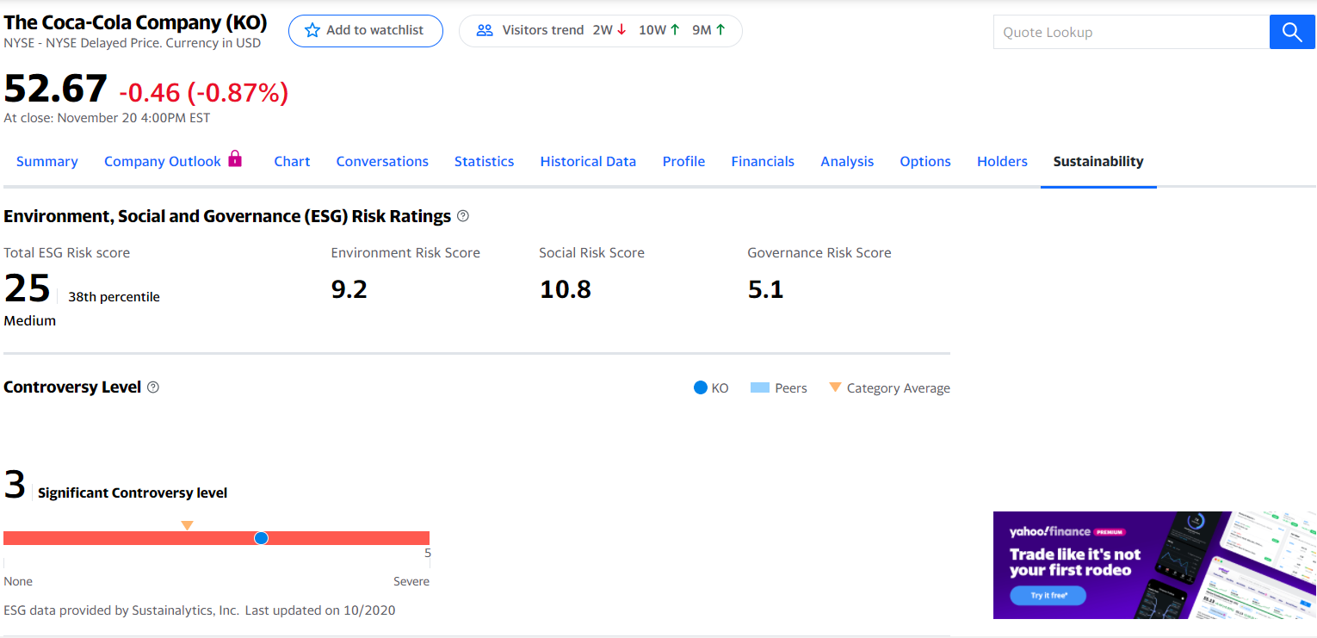
Web Scraping

Slide 13
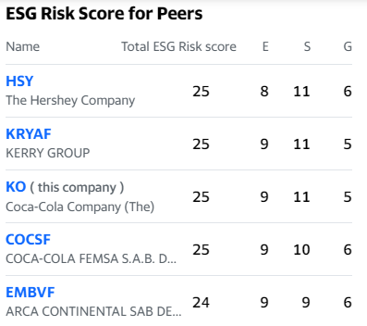
Analysis
Web Scraping is a technique we employed to extract large amounts of data from websites whereby the data is extracted and saved to a local file in your computer o
We used Beautiful Soup a Python package for parsing HTML and XML documents
We’ve attempted to analyze the ESG data in conjunction with the financial performance of the company.
We had our code ready for dashboarding and accidentally erased it in a merge mistake that removed a week of work. Attempts to resolve this were unfruitful and ultimately we do not have a dashboard to display, nor do we have a final analysis resolution.

Slide 14
Problem Solving
We’ve created an analysis tool that searches the web for data, and measures a particular characteristic of a company's performance or efficiency based on Key Performance Indicators(KPI's), financial data, and sustainability scores, outputs data, and compares it to companies relative to it's sector.
The result being an aggregated response with score and rating system based on how well a company did in complying with ESG standards, and meeting it's financial obligations, simultaneously, utilizing quantitative analysis, financial modeling, stock pricing, and data analytics, to quantify annualized returns on stock prices, revenue growth, net income growth, Earnings per share (EPS), Earnings Before Interest, Taxes, Depreciation, Amortization (EBITDA) , which may offer investors potential long-term performance advantages, in a growing market

Slide 15

Who would benefit from using this?
Fundamentally this analysis tool would be a used by individuals or DIY investors, the average person who wants explore investment opportunities through an ESG company that reflects the morals, and ideals of the individual, along with being a part of an environmentally conscious group of people who want to take part in more sustainable and socially responsible investing stratagem, while also having the option for a more diversified balanced portfolio that is current with economic, social, and environmental trends in developing industries.

Slide 16
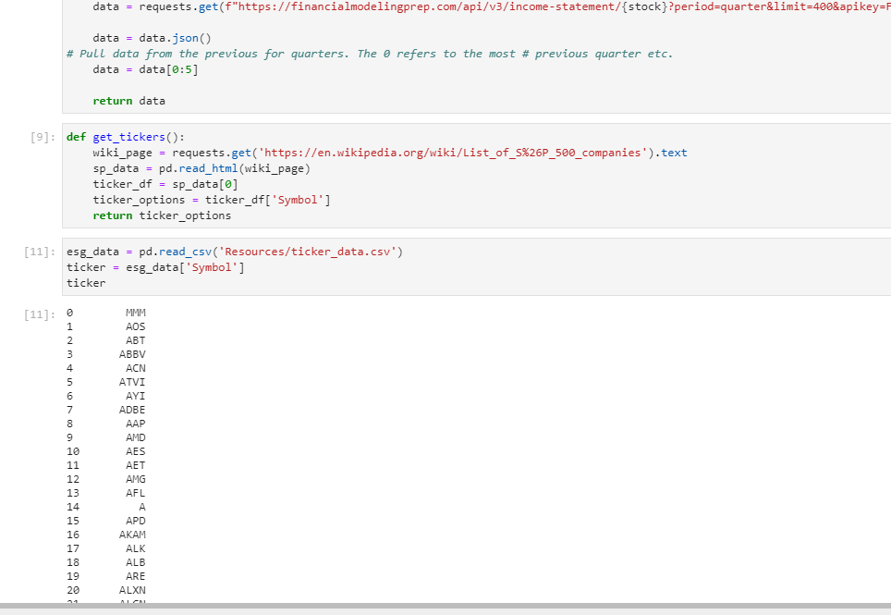
Data Cleaning & exploration
We used the inspect function on the web to identify font size, font weight, and the right margin of the sustainability scores.
SEC company filings were deleted from the csv file columns to remove from the data analysis.
We had taken the ticker symbols and concatenated it with the web scraping used in beautiful soup esg file, but the data was not presenting correctly. Additional attempts to fix created more errors.
Web scraping/ Data Extraction was implemented in our data gathering process

Slide 17
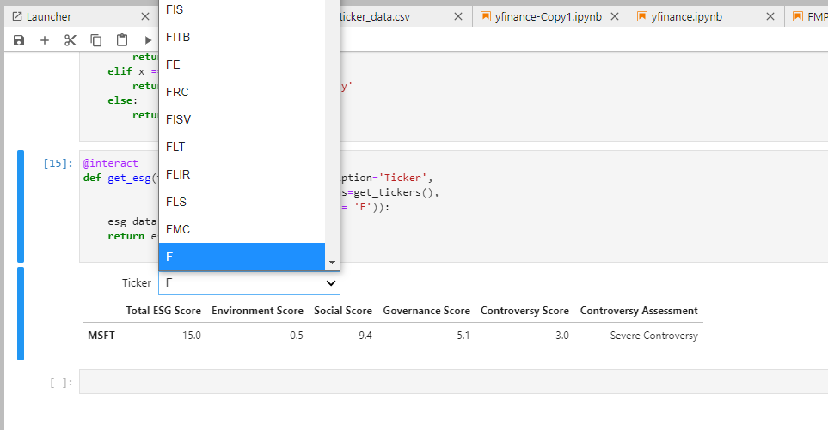
Desired output: one dataframe with the information for all tickers, instead of having them in an interactive dropdown display

Slide 18
Sources
Mediums.com,
yahoofinance.com,
Kaggle.com, iexCloud.com,
financialmodelingprep.com

